Slide 1
Near Surface Geophysics as Used in Geotechnical Site Investigations
Presented by
Simon Hughes

Slide 2
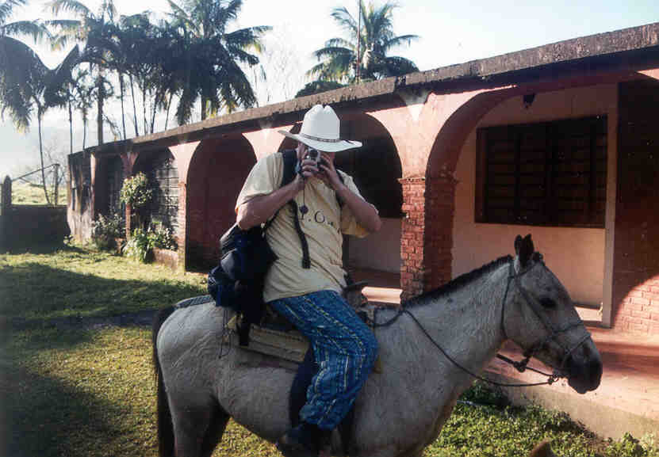
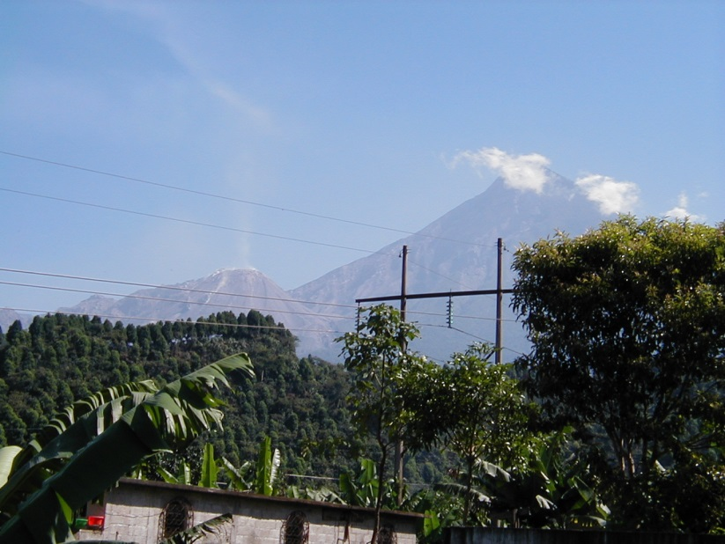
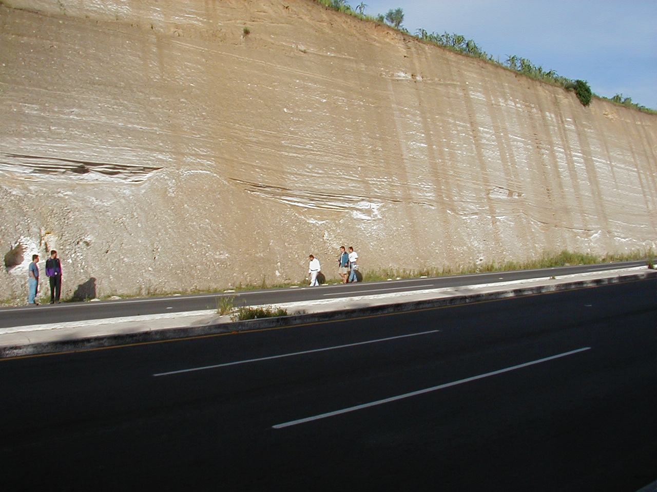

About me

Slide 3
Talk Contents
What is geophysics?
Benefits and advances in use
Case study – mine shafts
Case study - bypass
Case study – pipelines
Case study – wind farm
Other techniques

Slide 4

WHAT
IS GEOPHYSICS?
We need a RADAR survey – can you do it yesterday?

Slide 5
Geophysics is a magical black box!
Unintelligible pages of numbers
Too expensive
Unreliable
Inaccurate
Slow

Slide 6
“…a suite of measurement techniques that can be used to precisely measure physical properties
of the subsurface and the contrast with the target”
chargeability thermal conductivity resistivity seismic radioactivity velocity density magnetism electrokinesis dielectricity acoustic mass electromagnetic

Slide 7
Benefits of using geophysics

Slide 8
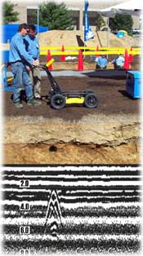
1: Non-invasive
“Ability to measure subsurface properties without need for excavation or drilling”
Ideal for urban / developed sites
Can be used on SSSIs
No reinstatement costs

Slide 9
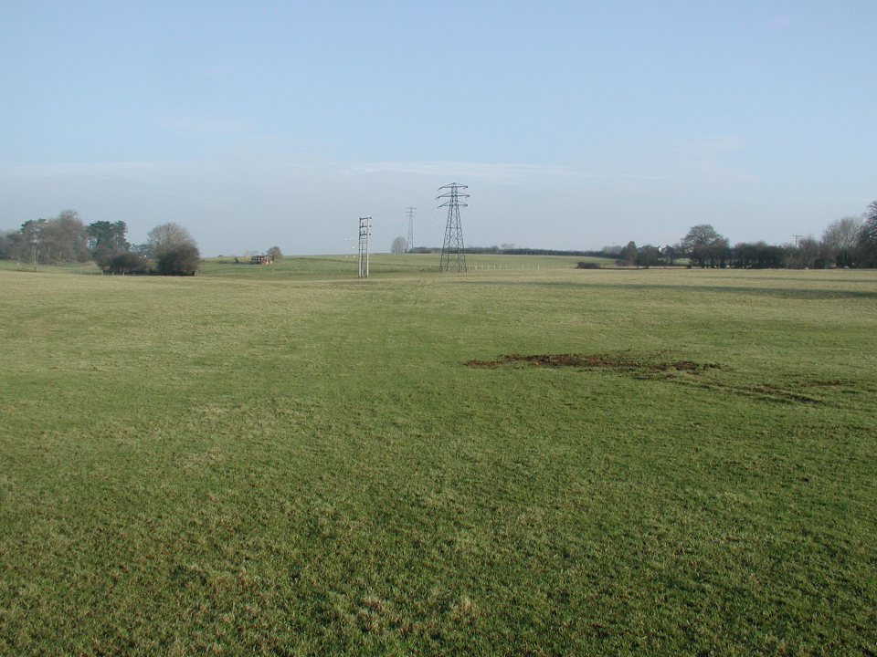
2: Total site coverage
Where would you drill?

Slide 10
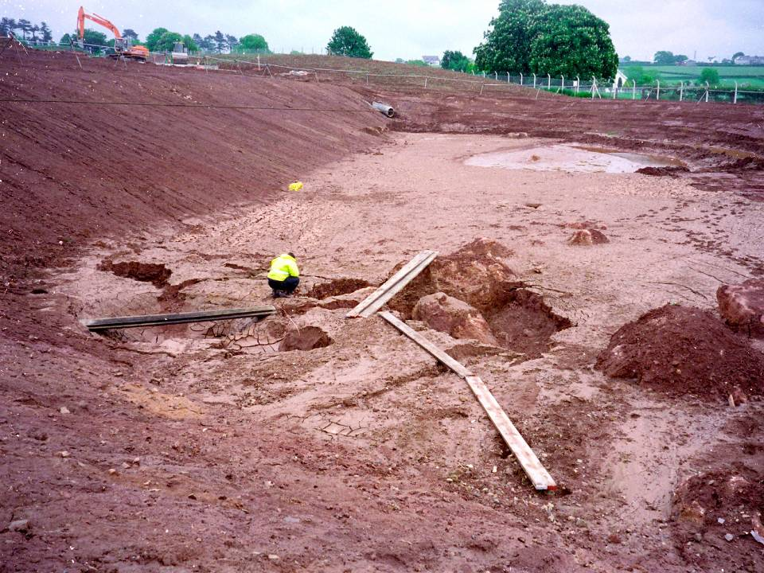
2: Total site coverage
You may have missed the solution feature!

Slide 11
3: Overcome errors in geological interpolation
“Geophysical data is continuous over a site or along a profile”
Avoids misinterpretation of bedrock e.g. borehole down fracture or into boulder

Slide 12
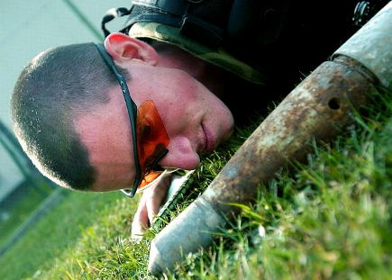
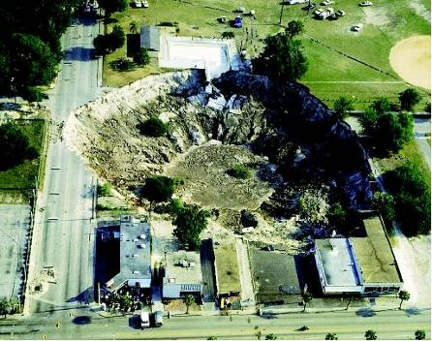
4: Low risk to site operatives from hazards
Chemical contamination
Unexploded ordnance
Voids and caverns
Pipelines or cables
Soft ground
Shafts or wells
Able to work on sensitive sites
No risk of cross-contamination through excavation

Slide 13
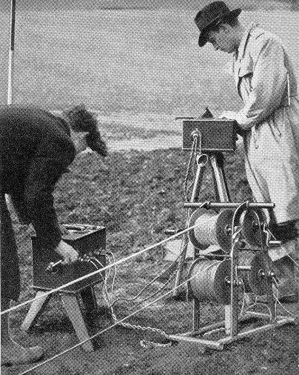
Recent advances
“Old” geophysics…
Slow
Non-portable
Analogue
Lower Resolution
Today’s methods based on same principles but…
Faster
Higher Resolution
More portable
Much more cost effective
1950 Megger Resistivity System

Slide 14
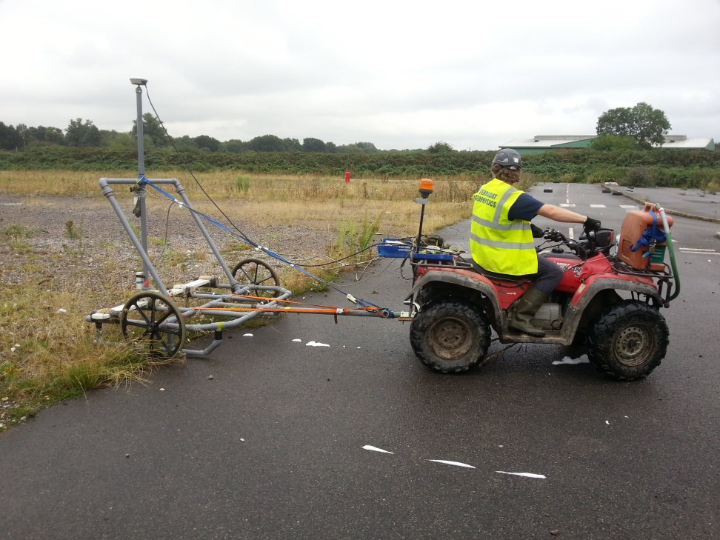
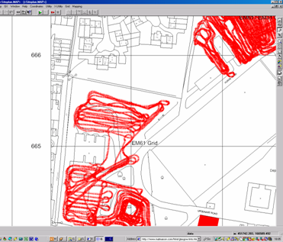
Recent advances
GPS positioning – greater speed & anomaly positioning

Slide 15
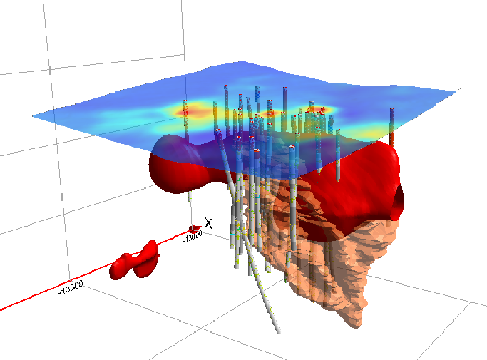
Recent Advances:
GIS and 3D integration of geophysics with other sources of data e.g.
Surveying
Historical
Geochemical
Geological
Aerial Photos
Notes:
Smaller, lighter instrumentation
Digital acquisition and storage
Real-time data display
Faster acquisition = higher resolution
GPS positioning
Increasing use in Industry
Improved Software Analysis

Slide 16
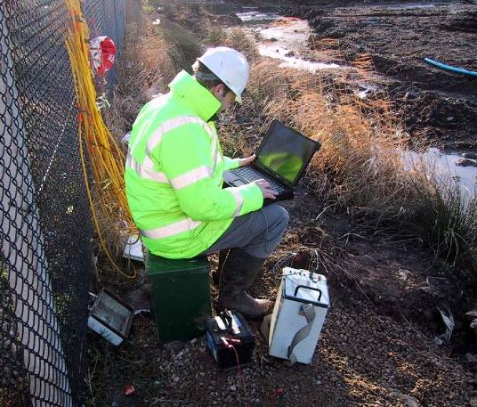
Recent Advances:
In-field analysis of data
Positioning of anomalies
Data QA
Optimal parameters

Slide 17
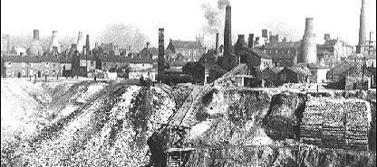
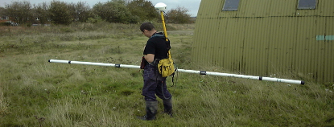
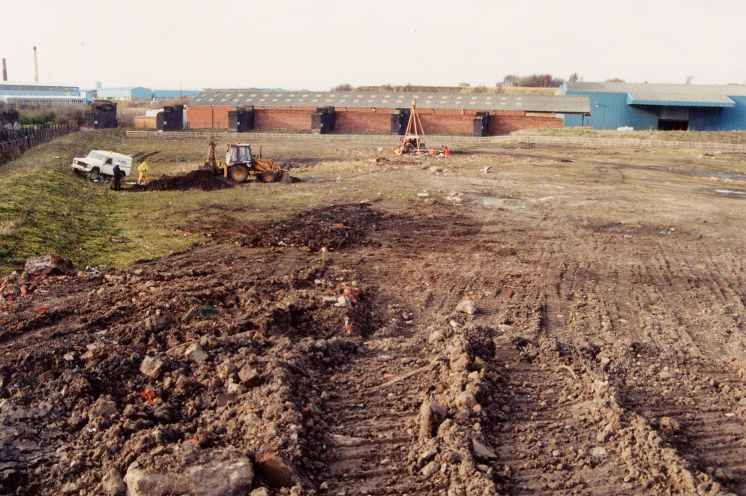
When to use geophysics?
Desk study
Site visit
GEOPHYSICS
Optimal design for borehole / sampling
Integration of data
Final conclusions

Slide 18
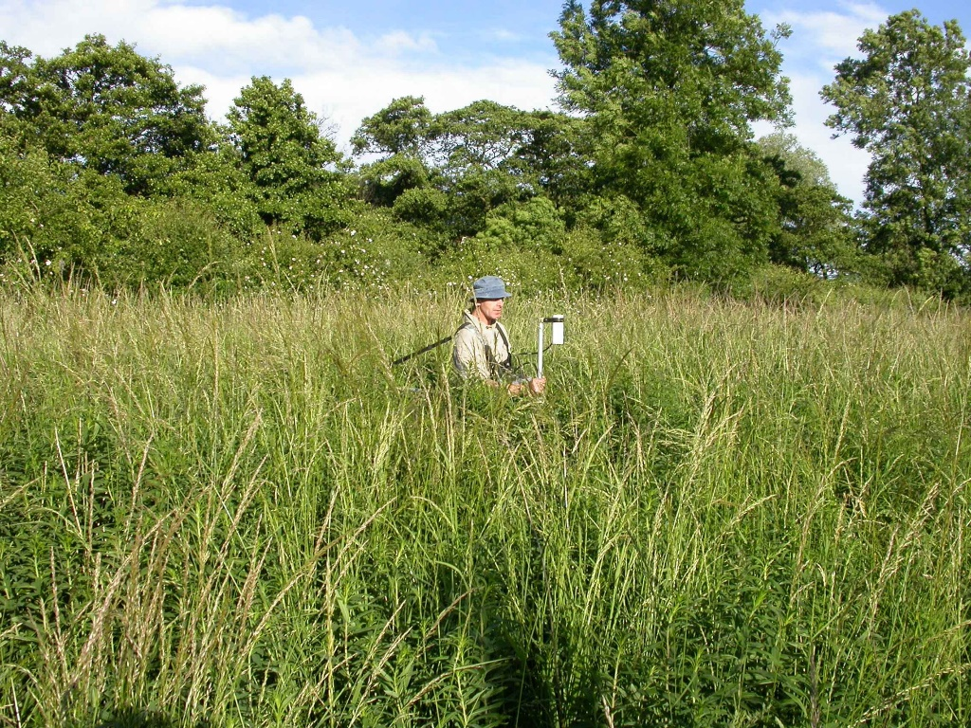
Issues with geophysics!
Poorly written spec.
Poor site conditions
Poor data quality
Poorly presented results
Wrong methods used
Lack of understanding

Slide 19
CASE STUDIES

Slide 20
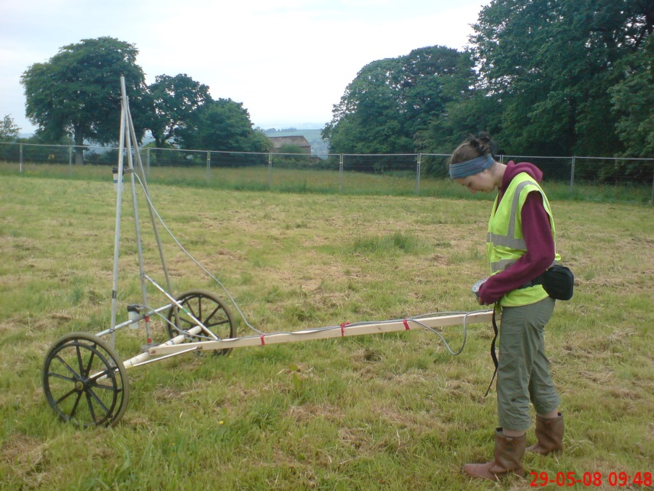
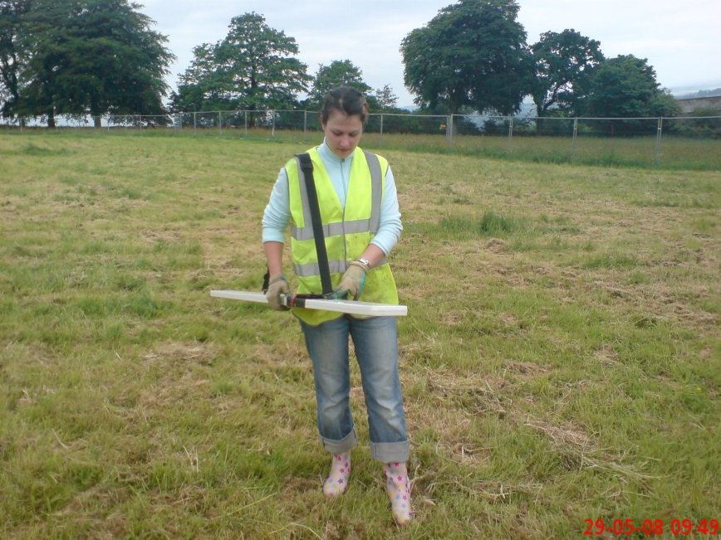
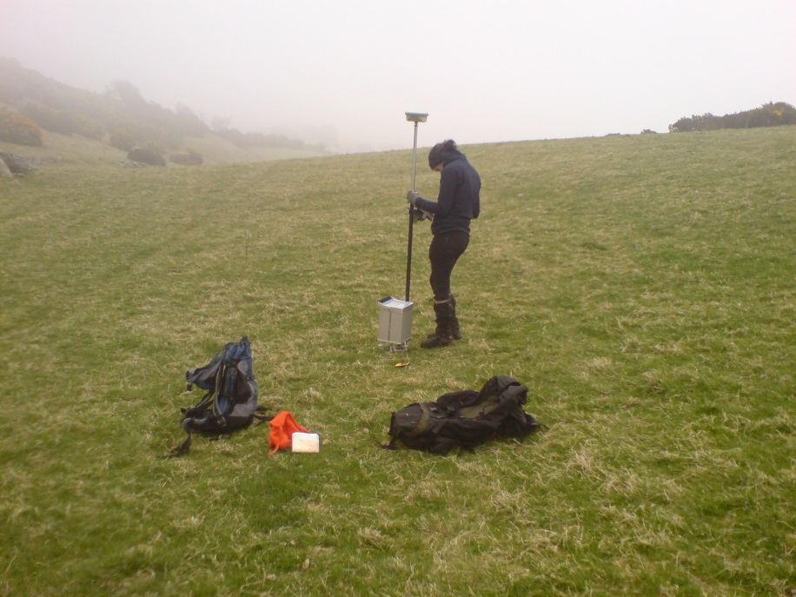
Case Study - mine shafts
Aim: to locate mineshaft under playing field for
school extension
Techniques:
conductivity
magnetic
microgravity

Slide 21
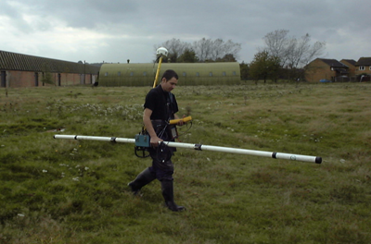
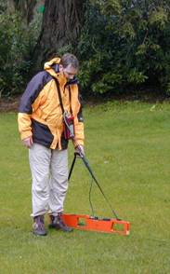
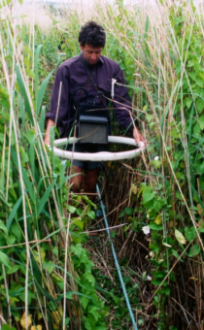
EM Conductivity
Background
Induced electromagnetic field gives measure of subsurface electrical conductivity to depths of 0.5-60 metres. Variation in conductivity due to: clay minerals, metal, water saturation, void space
Common Applications:
Shallow geology
Contamination plumes
Foundations and services
Buried pits or infilled quarries
Limitations
Noise from services / buildings

Slide 22
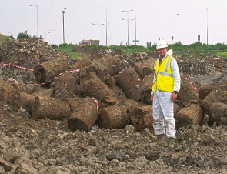
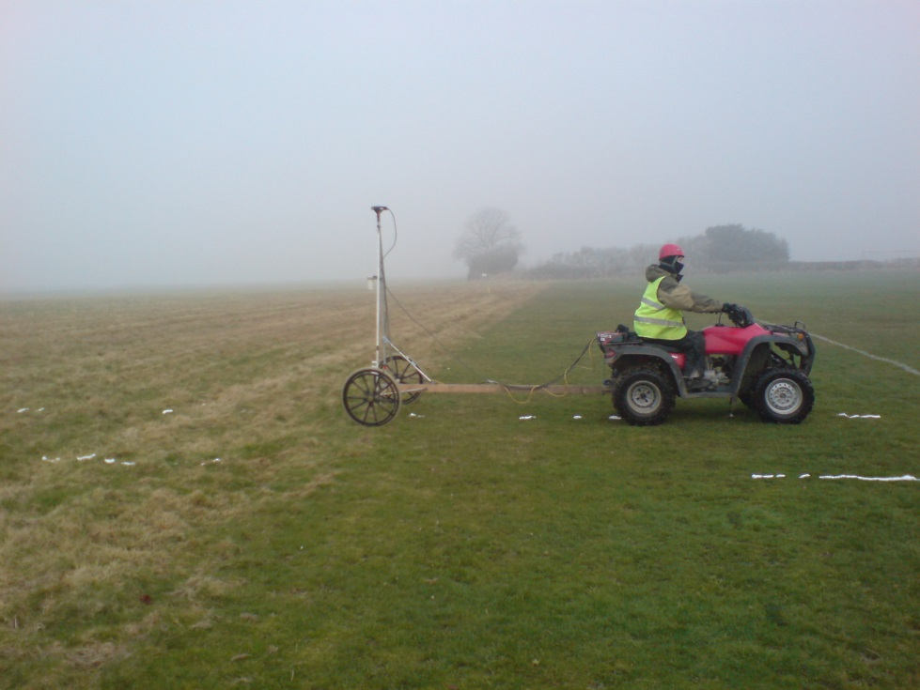
Magnetics
Theory:
“passive measurement of anomalies in the Earth’s magnetic field cause by buried ferrous objects”
Common Applications:
USTs and drums
UXO
Archaeology
Limitations:
Noise from services / buildings
Non-ferrous metal targets

Slide 23
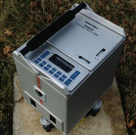
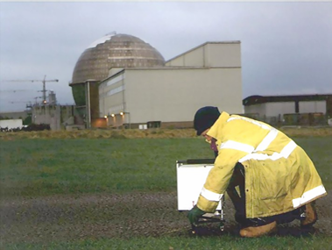
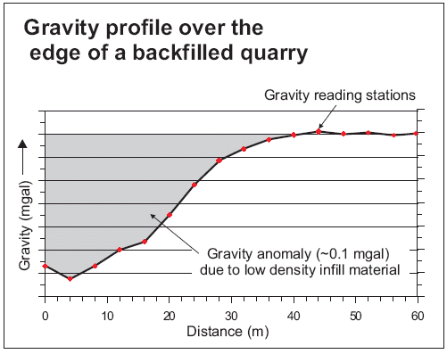
Microgravity
Theory: “Passive measurement of subtle variations in Earth’s gravity due to subsurface density changes caused by voids or different geological compositions.”
Common Applications:
Void and fissure mapping
Buried basements
Abandoned mine workings
Buried valleys
Limitations:
Acoustic noise & vibrations, wind, earthquakes
Speed of acquisition

Slide 24
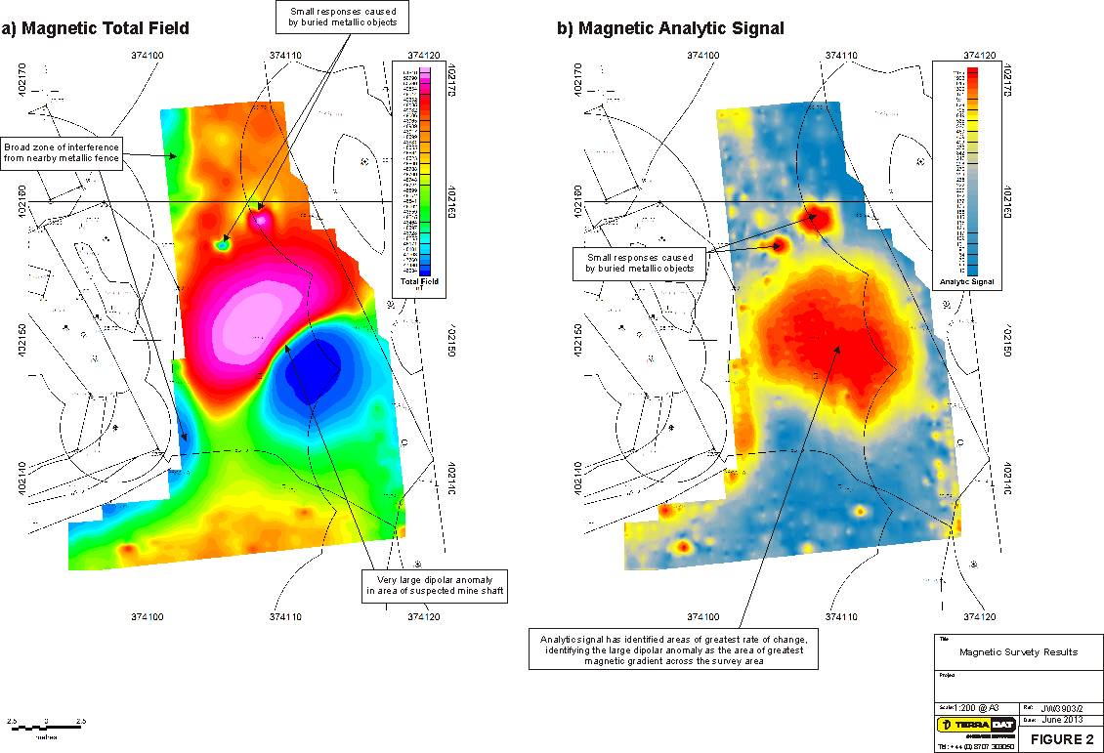
Case Study - mine shaft

Slide 25
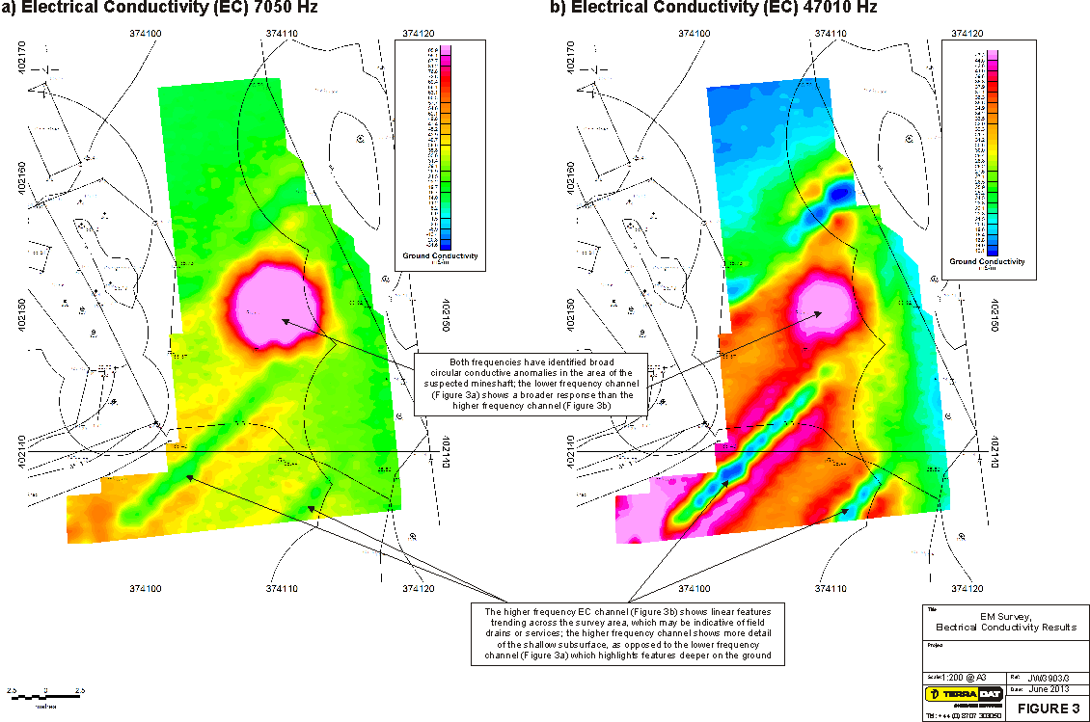
Case Study - mine shaft

Slide 26
Case Study - mine shaft

Slide 27
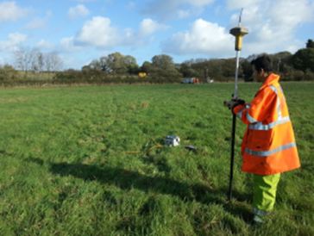
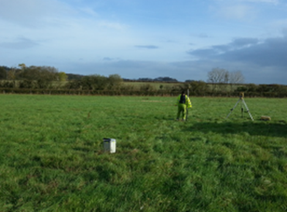
Case Study - bypass
Aim: to locate solution features along route of proposed bypass.
Technique: resistivity and follow-up microgravity if needed

Slide 28
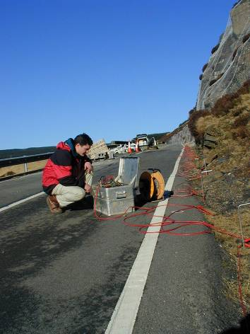
Resistivity
Theory: “ground resistance in relation to an induced DC electrical field is measured using electrode array.”
Common Applications:
bedrock profiling
buried channel mapping
overburden characterisation
landfill characterisation
Limitations:
Buried conductors e.g. rebar or cables
Geographical obstructions e.g. walls, cliffs

Slide 29
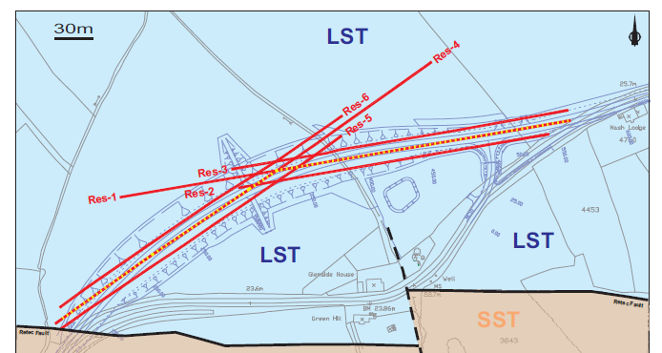
Case Study - bypass

Slide 30
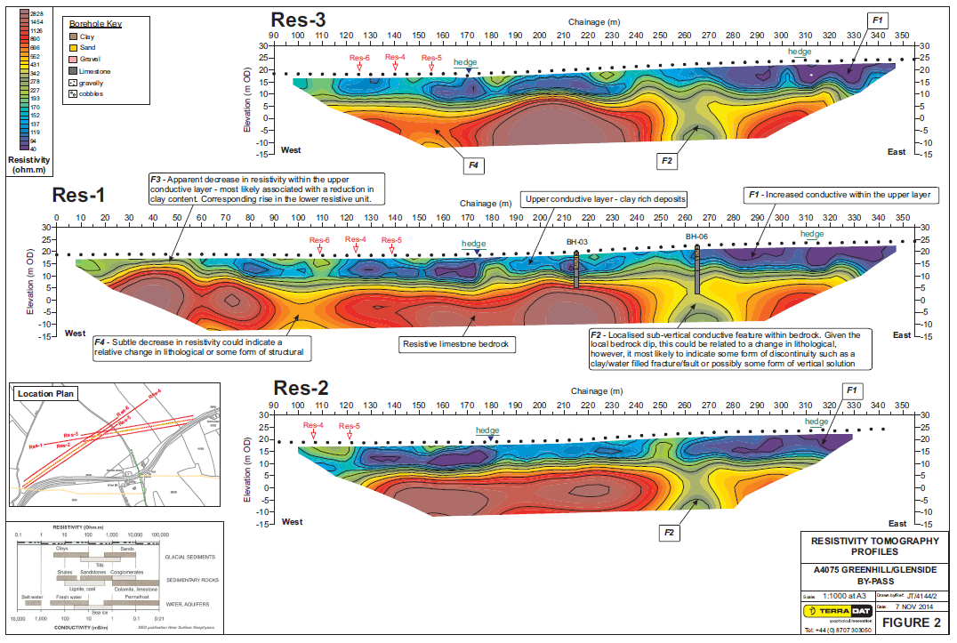
Case Study - bypass

Slide 31
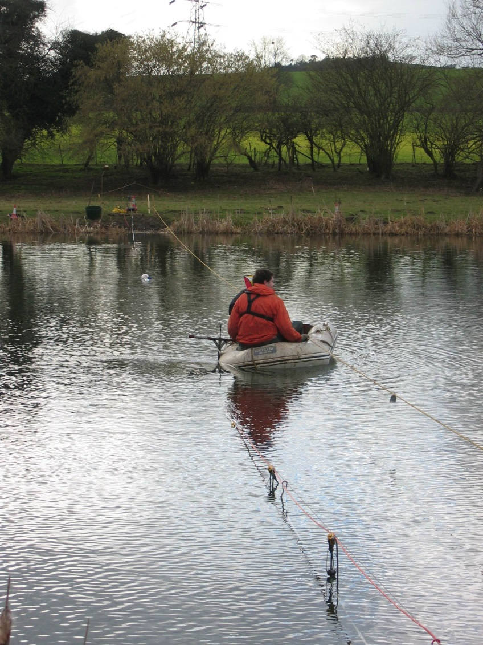
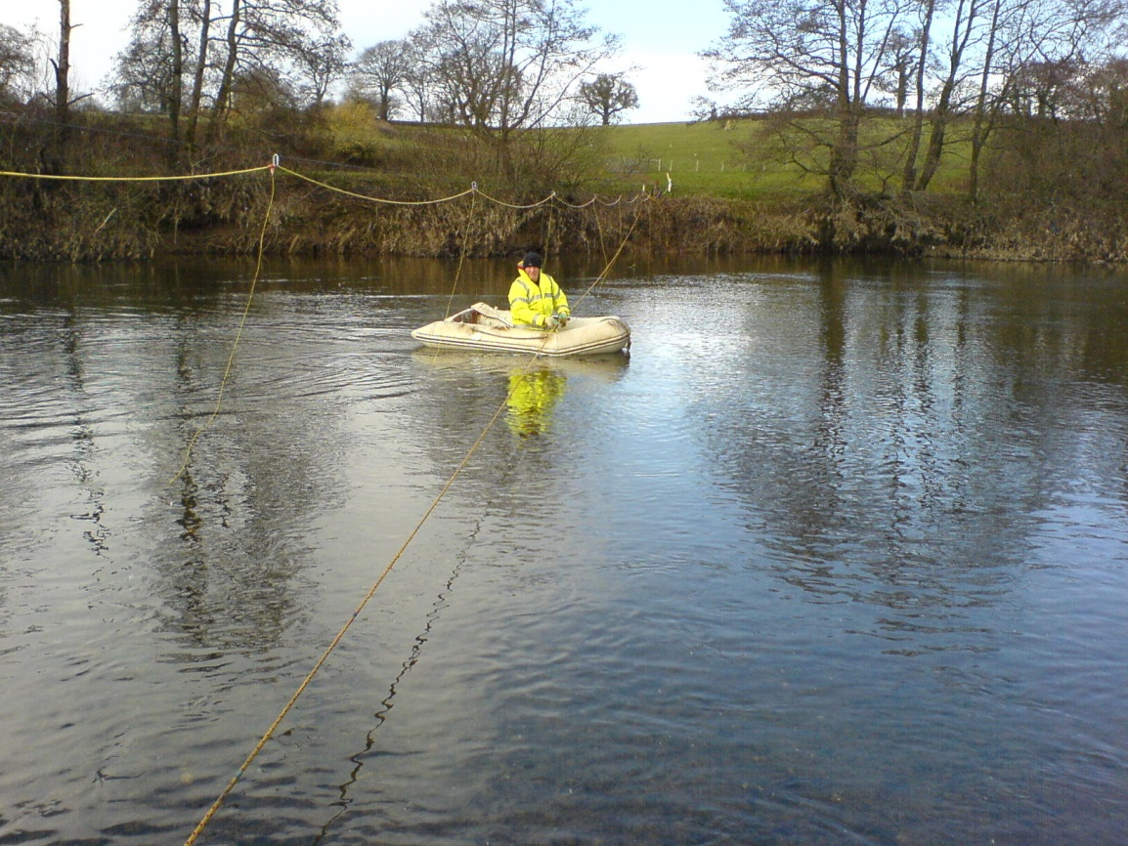
Case Study - pipeline
Aim: map bedrock profile for directional drilling
Techniques: resistivity and seismic

Slide 32
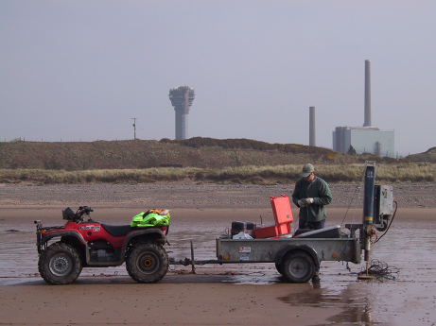
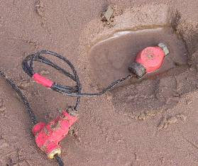
Seismic refraction
Theory: “measurement of subtle variations in the seismic velocity of subsurface materials”
Common Applications:
bedrock profiling
rock rippability
water table mapping
Limitations:
Acoustic noise / on site activity
Poor velocity contrast

Slide 33
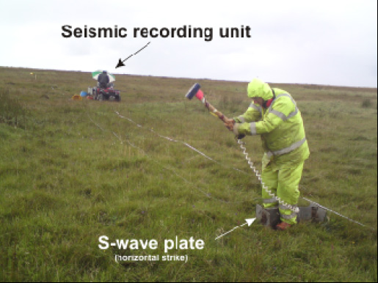
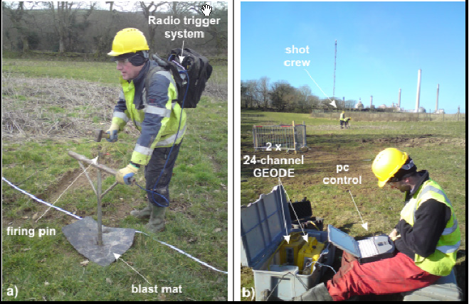
P wave refraction
- Rippability
S wave refraction
- Shear modulus and rock head
MASW
- Shear velocities and bulk data
A seismic section
(right) provides
detailed lateral
model for a
proposed
pipeline.
P wave refraction with
MASW (Stiffness) plot overlaid
- MASW often used in conjunction
with P + S wave due to its
ability to derive bulk values.

Slide 34
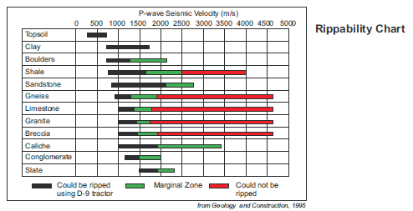
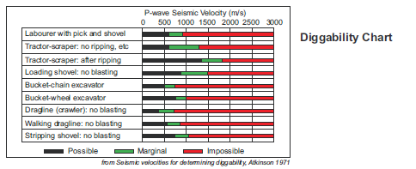
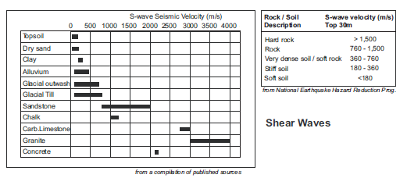
Seismic refraction

Slide 35
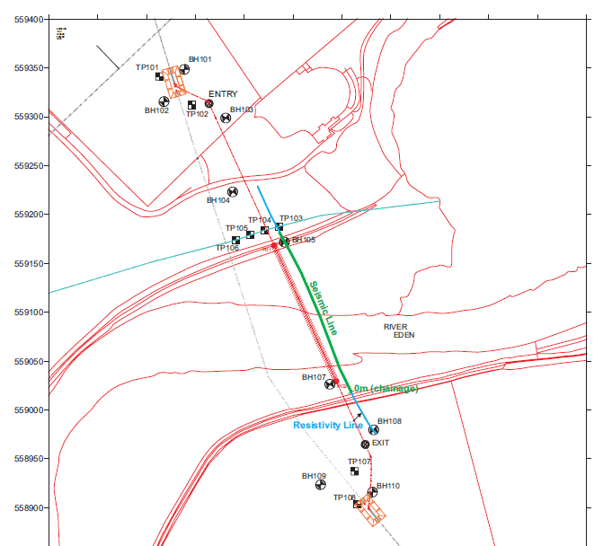
Case Study - pipeline

Slide 36
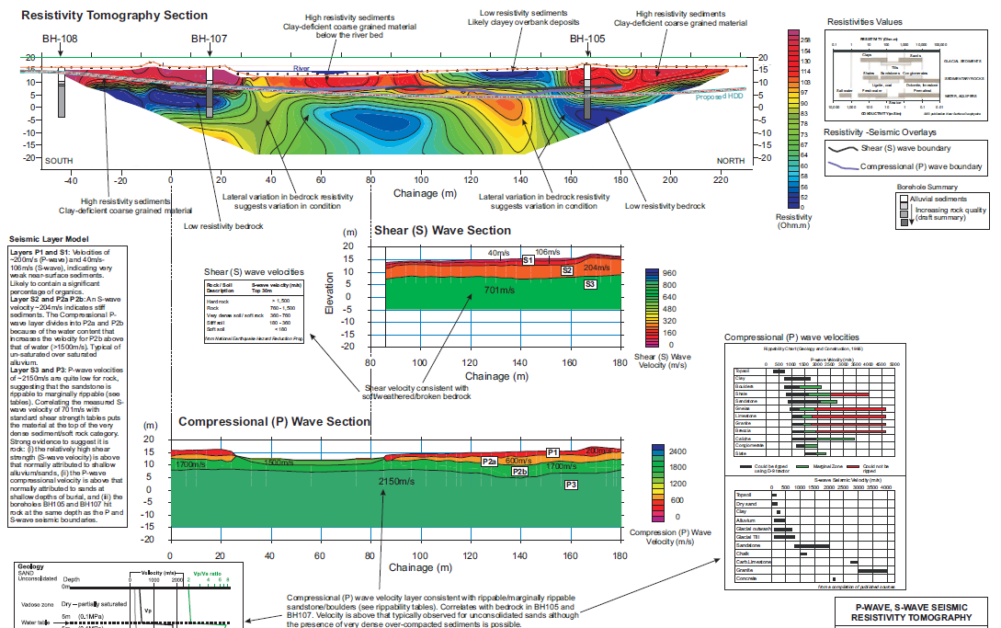
Case Study - pipeline

Slide 37
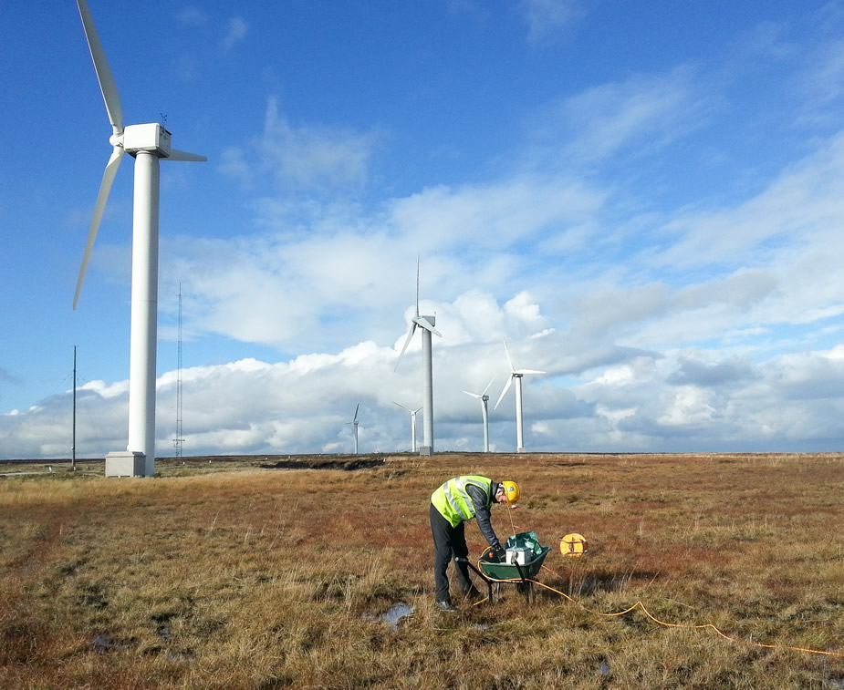
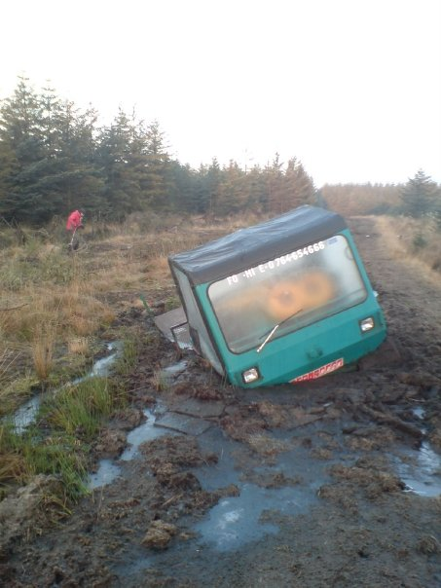
Case Study – wind farm
Aims: map depth to bedrock, geotechnical
properties for foundation design and soil
resistivity for earthing
Techniques: seismic and resistivity

Slide 38
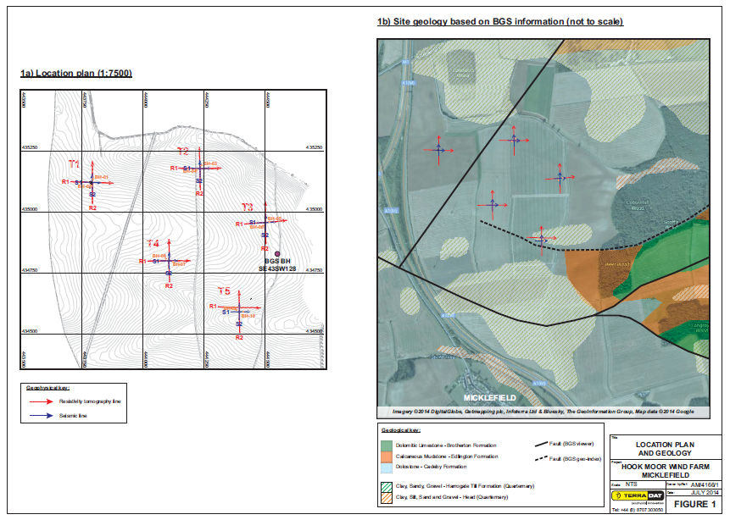
Case Study – wind farm

Slide 39
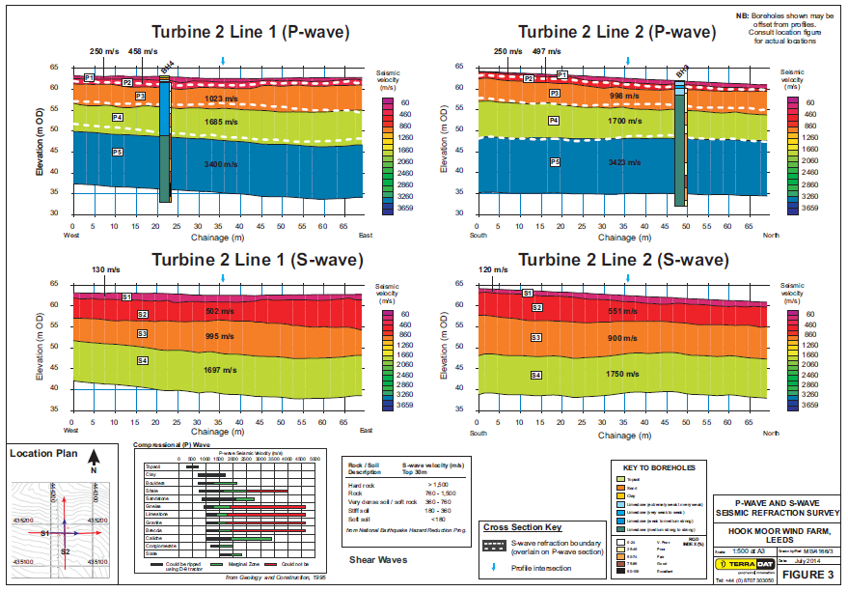
Case Study – wind farm

Slide 40

Case Study – wind farm

Slide 41


Case Study – wind farm
Seismic data
Soil resistivity
data

Slide 42


Techniques not covered

Slide 43

Techniques not covered - GPR

Slide 44

Techniques not covered – borehole seismic
Theory: Shooting either between boreholes (cross-hole) or from surface to borehole (down-hole)
Common Applications:
Caves/stopes/adits
Engineering properties
fracture zones
Buried valleys
Limitations:
Acoustic noise & vibrations
Bore hole separation distance (4.5 – 6 m)

Slide 45

Techniques not covered – borehole seismic

Slide 46

Techniques not covered – new!

Slide 47
You need a geophysical survey?
Aims and why - depth, size and nature of targets if known?
Size of the site?
Site cover (vegetated, building, rebar…)?
Geological setting?
Geographical setting?
Any existing desk study data?
Access limitations?

Slide 48

The End

